Slide 1
Object Oriented Software Engineering (OOSE)
22CS017
Software Project Estimation

Slide 2
Index
What is Estimation
Decomposition Technique- Problem Based Estimation
Function Point Analysis
Lines of Code
COCOMO Model
Practice Questions

Slide 3
Estimation
Estimation is the process of finding an estimate, or approximation, which is a value that can be used for some purpose even if input data may be incomplete, uncertain, or unstable.
Estimation determines how much money, effort, resources, and time it will take to build a specific system or product.
Estimation is based on:
Past Data/Past Experience
Available Documents/Knowledge
Assumptions
Identified Risks
The four basic steps in Software Project Estimation are −
Estimate the size of the development product.
Estimate the effort in person-months or person-hours.
Estimate the schedule in calendar months.
Estimate the project cost in agreed currency.

Slide 4
Decomposition Techniques - Problem Based Estimation
Lines of Code (LOC) and Function Point (FP) data are used in two ways during software project estimation:
as estimation variables to “size” each element of the software and
as baseline metrics collected from past projects and used in conjunction with estimation variables to develop cost and effort projections.

Slide 5
Decomposition Techniques - Problem Based Estimation
When LOC is used as the estimation variable, decomposition is absolutely essential and is often taken to considerable levels of detail.
The greater the degree of partitioning, the more likely reasonably accurate estimates of LOC can be developed.
For FP estimates, decomposition works differently. Each of the information domain characteristics—inputs, outputs, data files, inquiries, and external interfaces—as well as the 14 complexity adjustment values discussed are estimated.
The resultant estimates can then be used to derive an FP value that can be tied to past data and used to generate an estimate.

Slide 6
Function Point (FP) Analysis
The function point (FP) metric can be used effectively as a means for measuring the functionality delivered by a system.
The FP metric can then be used to
estimate the cost or effort required to design, code, and test the software;
predict the number of errors that will be encountered during testing; and
forecast the number of components and/or the number of projected source lines in the implemented system.
Function points are derived using an empirical relationship based on countable (direct) measures of software’s information domain value and qualitative assessments of software complexity.

Slide 7
Function Point (FP) Analysis
Information domain values are defined in the following manner:
Number of external inputs (EIs). Each external input originates from a user or is transmitted from another application and provides distinct application-oriented data or control information. Inputs are often used to update internal logical files (ILFs). Inputs should be distinguished from inquiries, which are counted separately.
Number of external outputs (EOs). Each external output is derived data within the application that provides information to the user. In this context external output refers to reports, screens, error messages, etc.

Slide 8
Function Point (FP) Analysis
Number of external inquiries (EQs). An external inquiry is defined as an online input that results in the generation of some immediate software response in the form of an online output (often retrieved from an ILF).
Number of internal logical files (ILFs). Each internal logical file is a logical grouping of data that resides within the application’s boundary and is maintained via external inputs.
Number of external interface files (EIFs). Each external interface file is a logical grouping of data that resides external to the application but provides information that may be of use to the application.

Slide 9
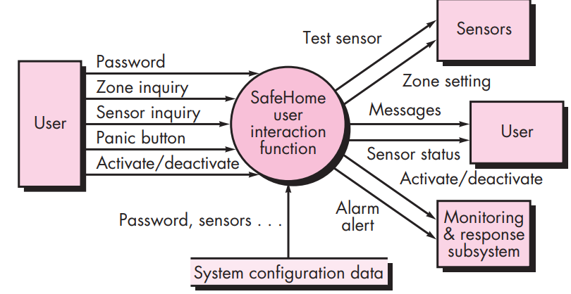
Function Point (FP) Analysis - Example
Figure1: Safe Home software data flow model example
Three external inputs (EIs) - password, panic button, and activate/deactivate
Two external inquiries (EQs) - zone inquiry and sensor inquiry.
One internal logical file (ILF) - system configuration file.
Two external outputs (EOs) - messages and sensor status.
Four external interface files (EIFs) - test sensor, zone setting, activate/deactivate, and alarm alert.

Slide 10
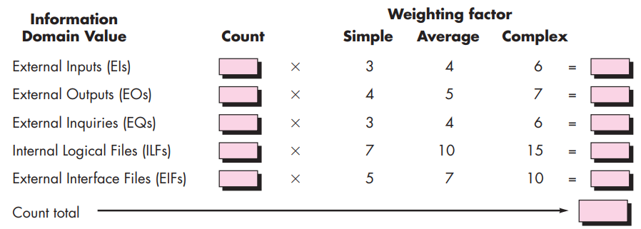
Function Point (FP) Analysis
Figure 2: Computing function points
To compute function points (FP), the following relationship is used:
Where count total is the sum of all FP entries obtained from the above table.

Slide 11
Function Point (FP) Analysis
The Fi (i = 1 to 14) are value adjustment factors (VAF) based on responses to the following questions:
Does the system require reliable backup and recovery?
Are specialized data communications required to transfer information to or from the application?
Are there distributed processing functions?
Is performance critical?
Will the system run in an existing, heavily utilized operational environment?
Does the system require online data entry?
Does the online data entry require the input transaction to be built over multiple screens or operations?
Are the ILFs updated online?
Are the inputs, outputs, files, or inquiries complex?
Is the internal processing complex?
Is the code designed to be reusable?
Are conversion and installation included in the design?
Is the system designed for multiple installations in different organizations?
Is the application designed to facilitate change and ease of use by the user?
Each of these questions is answered using a scale that ranges from 0 (not important or applicable) to 5 (absolutely essential).

Slide 12
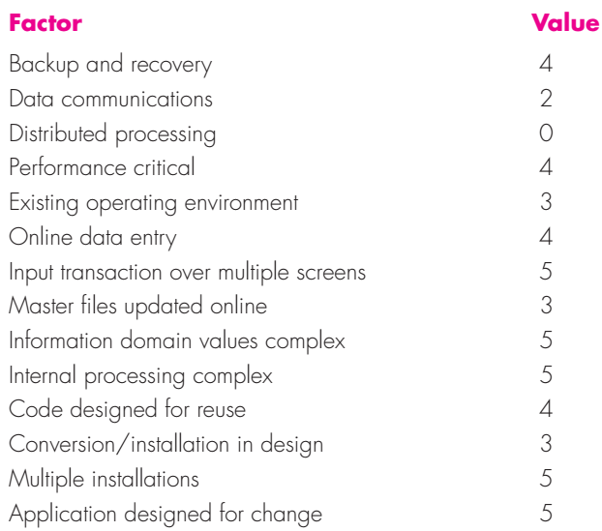
An Example of FP based Estimation

Slide 13
An Example of FP based Estimation
Assume count total to be equal to 320
The value adjustment factor ∑(Fi) is calculated as 52
Finally, the estimated number of FP is derived:
The organizational average productivity for systems of this type is 6.5 FP/pm.
Based on a burdened labor rate of $8000 per month, the cost per FP is approximately $1230.
Based on the FP estimate and the historical productivity data, the total estimated project cost is $461,250 and the estimated effort is 58 person-months.

Slide 14
An Example of LOC based Estimation
Consider a software package to be developed for a computer-aided design application for mechanical components.
A preliminary statement of software scope can be developed:
The mechanical CAD software will accept two- and three-dimensional geometric data from an engineer.
The engineer will interact and control the CAD system through a user interface that will exhibit characteristics of good human/machine interface design. All geometric data and other supporting information will be maintained in a CAD database.
Design analysis modules will be developed to produce the required output, which will be displayed on a variety of graphics devices. The software will be designed to control and interact with peripheral devices that include a mouse, digitizer, laser printer, and plotter.

Slide 15
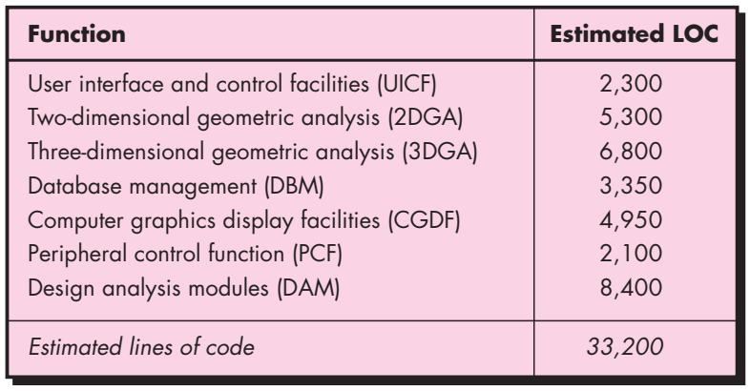
An Example of LOC based Estimation
For our purposes, assume that further refinement has occurred and that the major software functions are listed below. Following the decomposition technique for LOC, an estimation table is developed. A range of LOC estimates is developed for each function.

Slide 16
An Example of LOC based Estimation
By summing vertically in the estimated LOC column, an estimate of 33,200 lines of code (LOC) is established for the CAD system.
A review of historical data indicates that the organizational average productivity for systems of this type is 620 LOC/pm.
Based on a burdened labor rate of $8000 per month, the cost per line of code (LOC) is approximately $13.
Based on the LOC estimate and the historical productivity data, the total estimated project cost is $431,000 and the estimated effort is 54 person-months.

Slide 17
Empirical Based Estimation – COCOMO Model
COCOMO (Constructive Cost Model) is a regression model based on LOC, i.e number of Lines of Code. It is a procedural cost estimate model for software projects and often used as a process of reliably predicting the various parameters associated with making a project such as size, effort, cost, time and quality. It was proposed by Barry Boehm in 1970 and is based on the study of 63 projects, which make it one of the best-documented models.
The key parameters which define the quality of any software products, which are also an outcome of the COCOMO model are:
Effort: Amount of labor that will be required to complete a task. It is measured in person-months units.
Schedule: Simply means the amount of time required for the completion of the job, which is, of course, proportional to the effort put. It is measured in the units of time such as weeks, months.

Slide 18
COCOMO Model
Different models of COCOMO have been proposed to predict the cost estimation at different levels, based on the amount of accuracy and correctness required. All of these models can be applied to a variety of projects, whose characteristics determine the value of constant to be used in subsequent calculations.
SOFWATRE PROJECT TYPES:
Organic – A software project is said to be an organic type if the team size required is adequately small, the problem is well understood and has been solved in the past and also the team members have a nominal experience regarding the problem.

Slide 19
COCOMO Model
Semi-detached – A software project is said to be a Semi-detached type if the vital characteristics such as team-size, experience, knowledge of the various programming environment lie in between that of organic and Embedded. The projects classified as Semi-Detached are comparatively less familiar and difficult to develop compared to the organic ones and require more experience and better guidance and creativity.
Embedded – A software project with requiring the highest level of complexity, creativity, and experience requirement fall under this category. Such software requires a larger team size than the other two models and also the developers need to be sufficiently experienced and creative to develop such complex models.

Slide 20
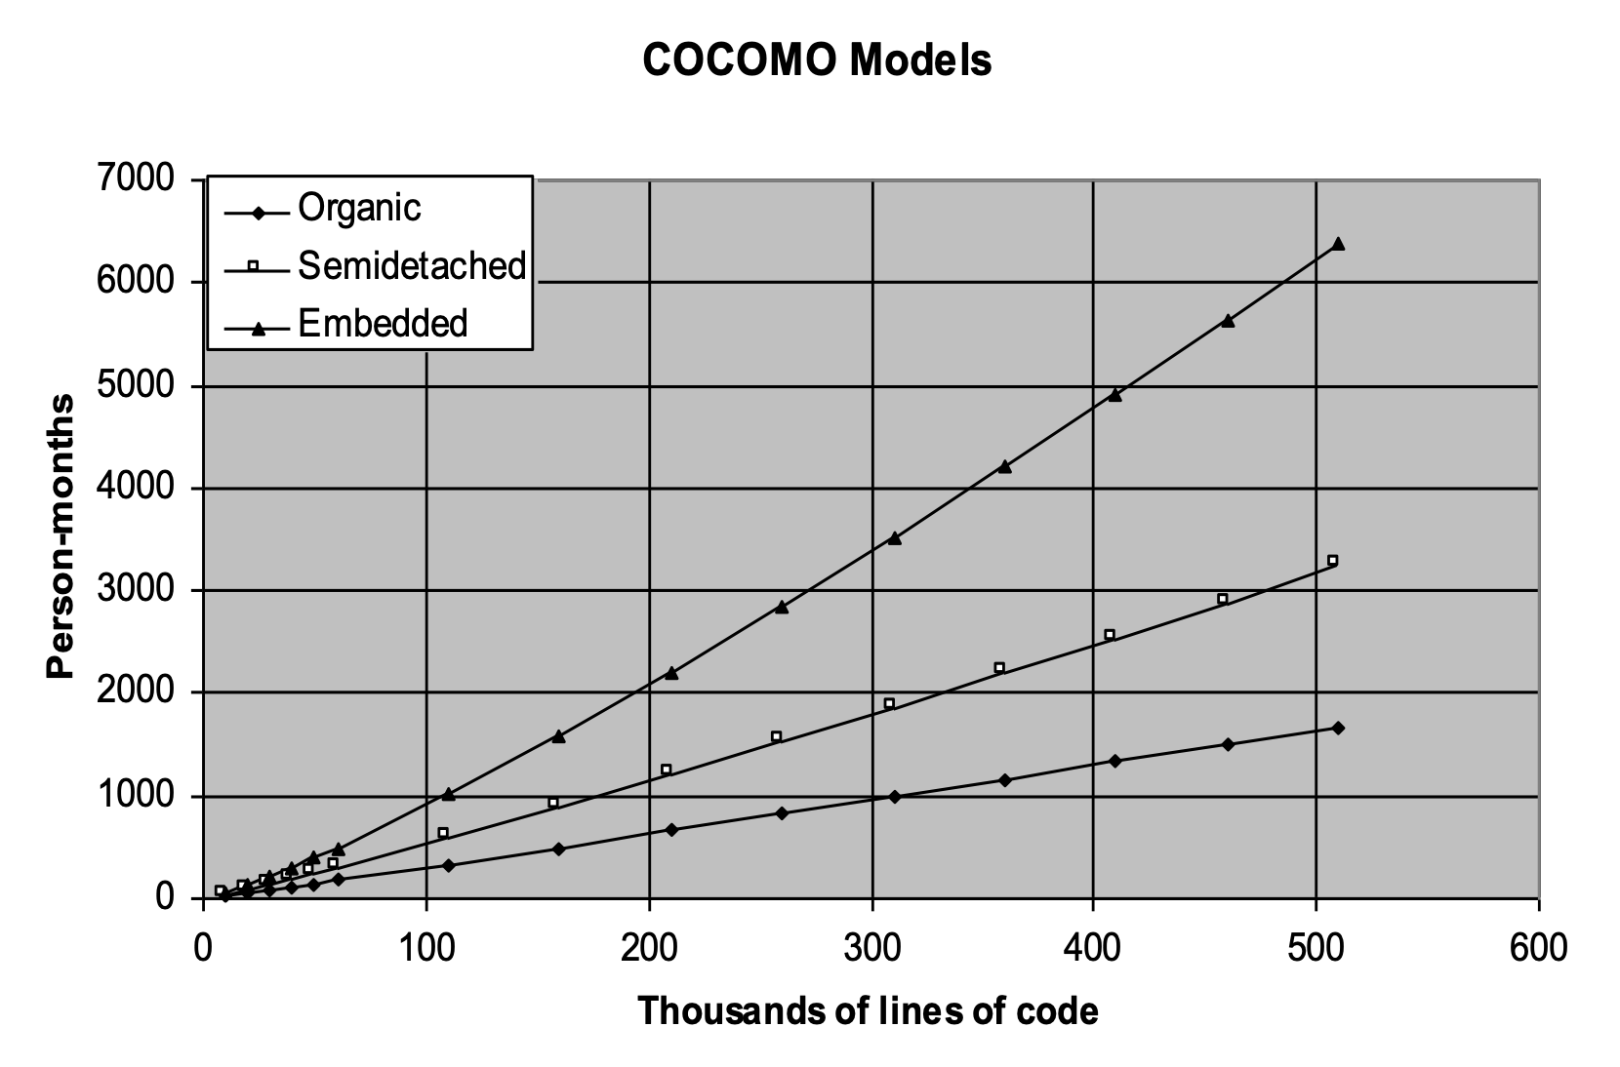
COCOMO Model
Figure3 : Graph of COCOMO Model

Slide 21
COCOMO Model Types
COCOMO consists of a hierarchy of three increasingly detailed and accurate forms:
Basic COCOMO Model
Intermediate COCOMO Model
Detailed COCOMO Model
The first level, Basic COCOMO can be used for quick and slightly rough calculations of Software Costs. Its accuracy is somewhat restricted due to the absence of sufficient factor considerations.
Intermediate COCOMO takes these Cost Drivers into account and Detailed COCOMO additionally accounts for the influence of individual project phases, i.e in case of detailed, it accounts for both these cost drivers and also calculations are performed phase wise henceforth producing a more accurate result.

Slide 22
Basic Model - Estimation of Effort
The above formula is used for the cost estimation of for the basic COCOMO model, and also is used in the subsequent models.
The constant values a, b, c and d for the Basic Model for the different categories of system are given in table.
The effort is measured in Person-Months
As evident from the formula is dependent on Kilo-Lines of code (KLOC).
The development time is measured in months.
E = a(KLOC)^{b}
time = c(Effort)^{d}
Person required = Effort/time
Software Projects | a | b | c | d
Organic | 2.4 | 1.05 | 2.5 | 0.38
Semi-Detached | 3.0 | 1.12 | 2.5 | 0.35
Embedded | 3.6 | 1.20 | 2.5 | 0.32

Slide 23
Basic Model - Estimation of Effort
Example1: Suppose a project was estimated to be 400 KLOC. Calculate the effort and development time for each of the three model i.e., organic, semi-detached & embedded.
Solution: The basic COCOMO equation takes the form:
Estimated Size of project= 400 KLOC E = a(KLOC)^{b}
time = c(Effort)^{d}
(i)Organic Mode
E = 2.4 × (400)^{1.05} = 1295.31 PM
D = 2.5 × (1295.31)^{0.38}=38.07 PM
(ii)Semidetached Mode
E = 3.0 × (400)^{1.12}=2462.79 PM
D = 2.5 × (2462.79)^{0.35}=38.45 PM
(iii) Embedded Mode
E = 3.6 × (400)^{1.20} = 4772.81 PM
D = 2.5 × (4772.8)^{0.32} = 38 PM

Slide 24
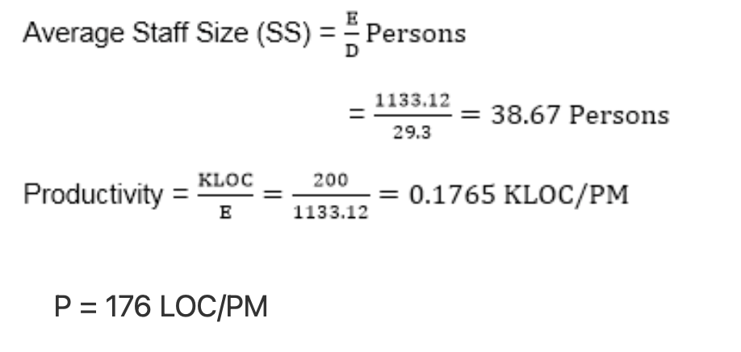
Basic Model - Estimation of Effort
Example 2: A project size of 200 KLOC is to be developed. Software development team has average experience on similar type of projects. The project schedule is not very tight. Calculate the Effort, development time, average staff size, and productivity of the project.
Solution: The semidetached mode is the most appropriate mode, keeping in view the size, schedule and experience of development time.
E = 3.0×(200)^{1.12} = 1133.12 PM D = 2.5× (1133.12)^{0.35} = 29.3 PM

Slide 25
Intermediate Model - Estimation of Effort
The basic COCOMO model assumes that the effort is only a function of the number of lines of code and some constants evaluated according to the different software systems.
However, in reality, no system’s effort and schedule can be solely calculated on the basis of Lines of Code.
For that, various other factors such as reliability, experience, capability.
These factors are known as Cost Drivers
The Intermediate Model utilizes 15 such drivers for cost estimation.

Slide 26
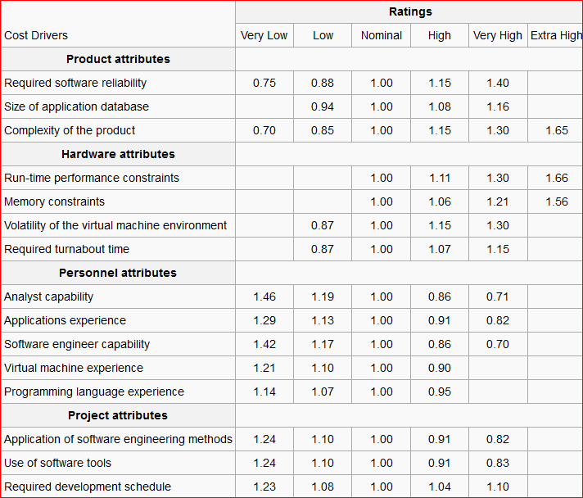
Intermediate Model - Estimation of Effort

Slide 27
Intermediate Model - Estimation of Effort
The project manager is to rate these 15 different parameters for a particular project on a scale of one to three.
Then, depending on these ratings, appropriate cost driver values are taken from the above table. These 15
values are then multiplied to calculate the EAF (effort adjustment Factor). The intermediate COCOMO
formula now takes the form:
E = (a(KLOC)^{b}) *EAF
The values of a and b in case of the intermediate model are as follows:
Software Projects | a | B
Organic | 3.2 | 1.05
Semi Detached | 3.0 | 1.12
Embedded | 2.8 | 1.20

Slide 28
Intermediate Model - Estimation of Effort
Example: For a given project was estimated with a size of 300 KLOC. Calculate the Effort, Scheduled time for development by considering developer having very high application experience and very low experience in programming.
Solution:
Given the estimated size of the project is: 300 KLOC
Developer having highly application experience: 0.82 (as per cost driver table)
Developer having very low experience in programming: 1.14 (as per cost driver table)
EAF = 0.82×1.14 = 0.9348
Effort (E) = a× (KLOC)^{b} ×EAF = 3.0× (300)^{1.12} ×0.9348 = 1668.07 MM
Scheduled Time (D) = c× (E)^{d} = 2.5× (1668.07)^{0.35} = 33.55 Months(M)

Slide 29
Detailed Model - Estimation of Effort
Detailed COCOMO incorporates all characteristics of the intermediate version with an assessment of the cost driver’s impact on each step of the software engineering process.
The detailed model uses different effort multipliers for each cost driver attribute.
In detailed COCOMO, the whole software is divided into different modules and then we apply COCOMO in different modules to estimate effort and then sum the effort.
The Six phases of detailed COCOMO are:
Planning and requirements
System design
Detailed design
Module code and test
Integration and test
Cost Constructive model

Slide 30
Practice Questions
Q1- Suppose that a project was estimated to be 400 KLOC. Calculate effort & time for each of 3 modes of development.
Software Product Type | a | b | c | d
Organic | 2.4 | 1.05 | 2.5 | 0.38
Semi-detached | 3.0 | 1.12 | 2.5 | 0.35
Embedded | 3.6 | 1.20 | 2.5 | 0.32
How do you estimate the cost of a project?
What are some common cost estimating tools and techniques?
How do you develop a cost estimate for a new project?

Slide 31
Bibliography
https://www.tutorialspoint.com/estimation_techniques/estimation_techniques_overview.htm
http://www.zeepedia.com/read.php?decomposition_techniques_estimation_tools_software_project_management&b=18&c=30
https://www.geeksforgeeks.org/software-engineering-cocomo-model/
https://study.com/academy/lesson/what-is-system-analysis-in-software-engineering.html
https://www.tutorialspoint.com/What-is-Data-Dictionary
https://www.lucidchart.com/pages/er-diagrams
https://www.datanamic.com/support/lt-dez006-what-is-an-erd.html

